Slide 1
Miscellaneous Practice Problems

Slide 2
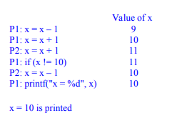
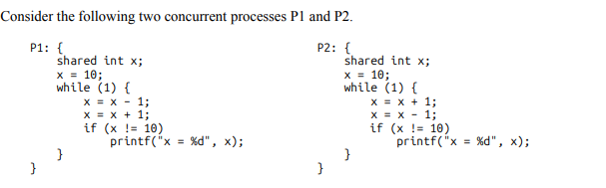
Problem 1
Can this program print x = 10?

Slide 3
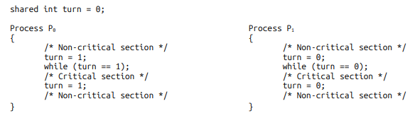
Problem 2
Not progress

Slide 4
Problem 3 – Extend Petersons Algorithm to 3 processes
int inCS[] = { 0, 0}; int turn = 0;
entrySection for P_i
inCS[i] = 1;
turn = 1 - i;
while (inCS[1-i] == 1 && turn == 1 - i);
/* CS */
exitSection for P_i
inCS[i] = 0;
int inCS[] = { ?}; int turn = 0;
entrySection for P_i
int j = ?;
int k = ?;
inCS[i] = ?;
turn = ?;
while ( ? && ??);
/* CS */
exitSection for P_i
inCS[i] = 0;

Slide 5
Solution
int inCS[] = { 0, 0, 0}; int turn = 0;
entrySection for P_i
int j = (i + 1) % 3;
int k = (i + 2) % 3;
inCS[i] = 1;
turn = j;
while ( (inCS[j] || inCS[k]) && (turn != i));
/* CS */
exitSection for P_i
inCS[i] = 0;

Slide 6
Three processes P0, P1, and P2 are running concurrently on a single-CPU system, where P2 has the highest priority. Currently, Process P1 is in the running state, P0 is waiting in the ready queue, and P2 is doing an I/O operation. After some time, P1 terminates and P2 completes I/O, simultaneously. Clearly list step by step all the events that will take place in the system, before the next process gets allocated to the CPU. Assume that the system implements a preemptive priority scheduler.
Problem 3

Slide 7
1. The resources allocated to P1 are released, and the PCB for P1 is removed from the process table. 2. The state in the PCB of P2 is changed from waiting to ready. 3. Now, there are two processes P0 and P2 in the ready state. The scheduler finds that P2 has higher priority than P0. 4. The scheduler changes the state in the PCB of P2 from ready to running. 5. The scheduler restores the context (registers) of P2 from its PCB to the CPU. 6. The scheduler loads the PC (program counter) of the CPU by the saved PC value in the PCB of P2.
Solution

Slide 8
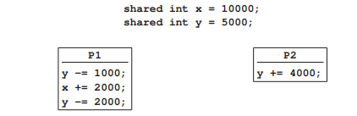
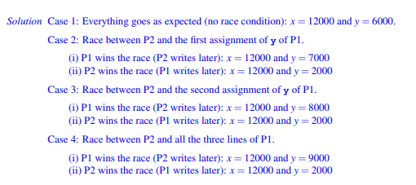
Different possible values of x, y when P1, P2 finish?
Problem 4

Slide 9
Problem 5
Four concurrent processes P,Q,R,S are running on a system. All these four processes access a shared variable x initialized to zero. These four processes are implemented as follows. Each of the processes P and Q reads x from memory, increments by one, stores it to memory, and then terminates. Each of the processes R and S reads x from memory, decrements by two, stores it to memory, and then terminates. Each process invokes the wait() operation on a counting semaphore count before reading x, and invokes the signal() operation on the semaphore count after storing x to memory. The semaphore count is initialized to two (2). What is the maximum possible value of x after all processes complete execution? Explain your answer.

Slide 10
Solution
Semaphore count is initialized to 2. Process P executes making count = 1 and x = 1, but it does not update the x variable. Then, process R executes making count = 0. It decrements x, stores x = −2, and signals semaphore making count = 1. Now, process S runs completely making count = 0, x = −4, and finally count = 1 (after signal). Now, process P stores x = 1 and signals the semaphore to count = 2. Finally, process Q making x = 2. Evidently, x cannot store a value larger than 2, since only two processes increment it (by 1).

Slide 11
Synchronization and Deadlock Practice Question

Slide 12
Q1. GATE 1992
At a particular time of computation, the value of a counting semaphore is 7. Then 20 WAIT (P) operations and 15 SIGNAL (V) operations were completed on this semaphore. The resulting value of the semaphore is :
7 - 15 + 15 - 5 = 2

Slide 13
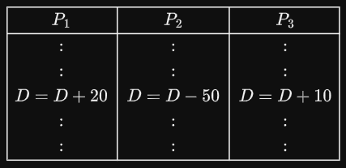
Q 2. GATE 2019
Consider three concurrent processes P1, P2 and P3 as shown below, which access a shared variable D that has been initialized to 100.
The processes are executed on a uniprocessor system running a time-shared operating system. If the minimum and maximum possible values of D after the three processes have completed execution are X and Y respectively, then the value of Y-X is ______
Steps to get minimum Value (X) -
P2 reads D=100 and then context switches
P1 and P3 complete, context switches to P2
P2 decrements D=100 by 50
X = 50

Slide 14
Q 2. GATE 2019 (contd.)
Consider three concurrent processes P1, P2 and P3 as shown below, which access a shared variable D that has been initialized to 100.
The processes are executed on a uniprocessor system running a time-shared operating system. If the minimum and maximum possible values of D after the three processes have completed execution are X and Y respectively, then the value of Y-X is ______
80
Steps to get maximum Value (Y) -
P1 reads D=100 and then context switches to P2
P2 complete, context switches to P1
P1 completes making D=120.
P3 reads D = 120 and writes d = 130
Y = 130

Slide 15
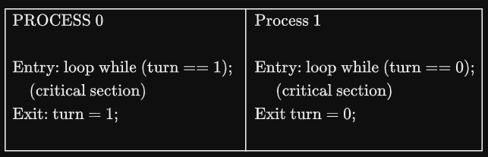
Q3. GATE 2016
Consider the following two-process synchronization solution. The shared variable turn is initialized to zero. Which one of the following is TRUE?
This is a correct two- process synchronization solution.
This solution violates mutual exclusion requirement.
This solution violates progress requirement.
This solution violates bounded wait requirement.
Turn = 0
P0 does not want to enter CS
P1 wishes to enter CS, but waits for P0
Even though CS is empty, no one is allowed to enter. Hence, PROGRESS VIOLATED
TRUE

Slide 16
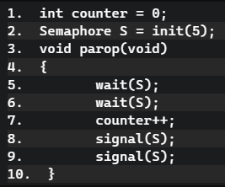
Q4. GATE 2021
Consider the following pseudocode, where S is a semaphore initialized to 5 in line #2 and counter is a shared variable initialized to 0 in line #1. Assume that the increment operation in line is not atomic. If five threads execute the function concurrently, which of the following program behavior(s) is/are possible?
The value of counter is 5 after all the threads successfully complete the execution of parop
The value of counter is 1 after all the threads successfully complete the execution of parop
The value of counter is 0 after all the threads successfully complete the execution of parop
There is a deadlock involving all the threads

Slide 17
Solution
The value of counter is 5 after all the threads successfully complete the execution of parop
POSSIBLE - All processes execute sequentially
The value of counter is 1 after all the threads successfully complete the execution of parop
POSSIBLE - Increment operation is not atomic. Suppose,
P1 reads counter value and there is a context switch
P2 - P5 complete execution making counter 4, then context switches back to P1
Before switching P1 read value of counter to be 0, hence does 0++, making the final value of counter to be 1
The value of counter is 0 after all the threads successfully complete the execution of parop
NOT POSSIBLE!!
There is a deadlock involving all the threads
POSSIBLE - P1-P5 execute first wait(S) and gets blocked on the second one as S=0.

Slide 18
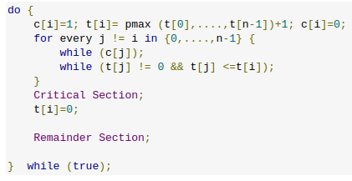
Q5. (Gate 2016)
Consider the following proposed solution for the critical section problem. There are n processes : P₀, P₁, …, P_{n-1}. In the code, function returns an integer not smaller than any of its arguments. For all i, t[i] is initialized to zero.
Code for P_{i};
Which of the following is TRUE about the above solution?
At most one process can be in the critical section at any time
The bounded wait condition is satisfied
The progress condition is satisfied
It cannot cause a deadlock

Slide 19
Reasoning:-
At most 1 process can be in CS at a time
TRUE - When t[i] = t[j] and i != j, then both processes wait but never enter together
Bounded waiting is satisfied
FALSE - When same token is assigned to 2 processes, both wait indefinitely
Progress condition is satisfied
FALSE - 2 processes with same token number wait even though the CS is empty
Cannot cause Deadlock
FALSE - Progress is violated

Slide 20
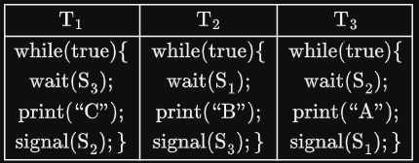
Q6. GATE 2022
Consider the following threads, T1, T2 and T3 executing on a single processor, synchronized using three binary semaphore variables, S1, S2 and S3 operated upon using standard wait() and signal(). The threads can be context switched in any order and at any time. What initialization of the semaphores would print the sequence BCABCABCA…?
We want these to execute as: T2, T1, T3 and repeat.
Initialize S1 = 1
S2 = 0
S3 = 0

Slide 21
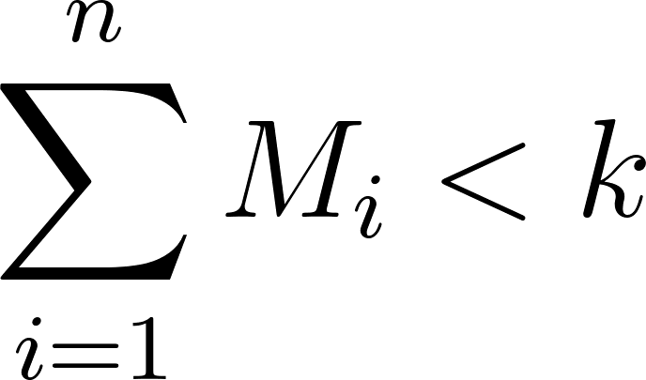

Q7. (Gate 2026)
A system has 5 processes and k instances of a resource R. Assume each process requires a maximum of 2 instances of R. A process can request or release only one instance at a time. Further, a process can request the second instance of R only after acquiring the first instance. The minimum possible value of k required to ensure a deadlock-free environment is ____.
For n processes where each process P_{i} has a maximum demand : The condition for a deadlock-free environment is:
Plugging in your values:(2−1)+(2−1)+(2−1)+(2−1)+(2−1)<k implies, 5<k
Since k must be an integer, the minimum value is 6.

Slide 22
Q8. ISI M.Tech CS Semester Exam 2005
State the four necessary conditions for deadlock and briefly explain how these conditions are fulfilled by the dining philosophers problem.
Four Necessary Conditions for Deadlock:-
Mutual Exclusion: At least one resource must be held in a non-sharable mode (only one process can use it at a time).
Hold and Wait: A process is holding at least one resource and waiting to acquire additional resources held by others.
No Preemption: Resources cannot be forcibly taken from a process; they must be released voluntarily.
Circular Wait: A set of processes exists such that each is waiting for a resource held by the next member in the chain.

Slide 23
Solution to Q8 (contd.)
Dining Philosophers Problem: Five philosophers sit at a round table with a bowl of rice and five single chopsticks placed between them. To eat, a philosopher must acquire two chopsticks (left and right).
Mutual Exclusion: A chopstick can be held by only one philosopher at a time.
Hold and Wait: A philosopher picks up one chopstick (Hold) and waits for the second one (Wait).
No Preemption: A philosopher will not drop their chopstick until they have finished eating.
Circular Wait: If every philosopher picks up their left chopstick simultaneously, they all wait indefinitely for the right chopstick held by their neighbor, forming a closed loop.

Slide 24
Q9. ISI M.Tech CS Semester Exam 2010
Consider the following implementation of a producer and a consumer process:
Producer Consumer
p = produce(); while (count==0); // empty
while (count==n); // full p = buffer[out];
buffer[in] = p; out = (out+1) % n;
in = (in+1) % n; count- -;
count++; consume(p);
The producer and consumer have to be synchronized using a single semaphore, S.
(i) Insert appropriate calls to wait(S) and signal(S) in the above code, so that the processes are properly synchronized.
(ii) Show how you would use the semget() and semctl() system calls to create and initialize S.
(iii) Show how you would implement the wait(S) and signal(S) functions using the semop() system call.

Slide 25
Solution to Q9
(i) To protect the shared data and prevent a Race Condition, the semaphore S (initialized to 1) acts as a mutex.
Producer Consumer
p = produce(); while (count==0); // empty
while (count==n); // full Wait (S)
Wait (S) p = buffer[out];
buffer[in] = p; out = (out+1) % n;
in = (in+1) % n; count- -;
count++; Signal(S)
Signal (S) consume(p);

Slide 26
Solution to Q9 (contd.)
(ii) In Unix-based systems, we use semget to create the semaphore set and semctl to set the initial value.
// 1. Create a semaphore set with 1 semaphore
int semid = semget(IPC_PRIVATE, 1, 0666 | IPC_CREAT);
// 2. Initialize the semaphore (index 0) to 1 (Binary Semaphore/Mutex)
union semun {
int val;
} argument;
argument.val = 1;
semctl(semid, 0, SETVAL, argument);

Slide 27
Solution to Q9 (contd.)
(iii)The semop() system call performs atomic operations on semaphores using the sembuf structure.
wait(S) Implementation:
void wait(int semid) {
struct sembuf sb = {0, -1, 0}; // Index 0, Decrement by 1, No flags
semop(semid, &sb, 1);
}
signal(S) Implementation:
void signal(int semid) {
struct sembuf sb = {0, 1, 0}; // Index 0, Increment by 1, No flags
semop(semid, &sb, 1);
}

Slide 28
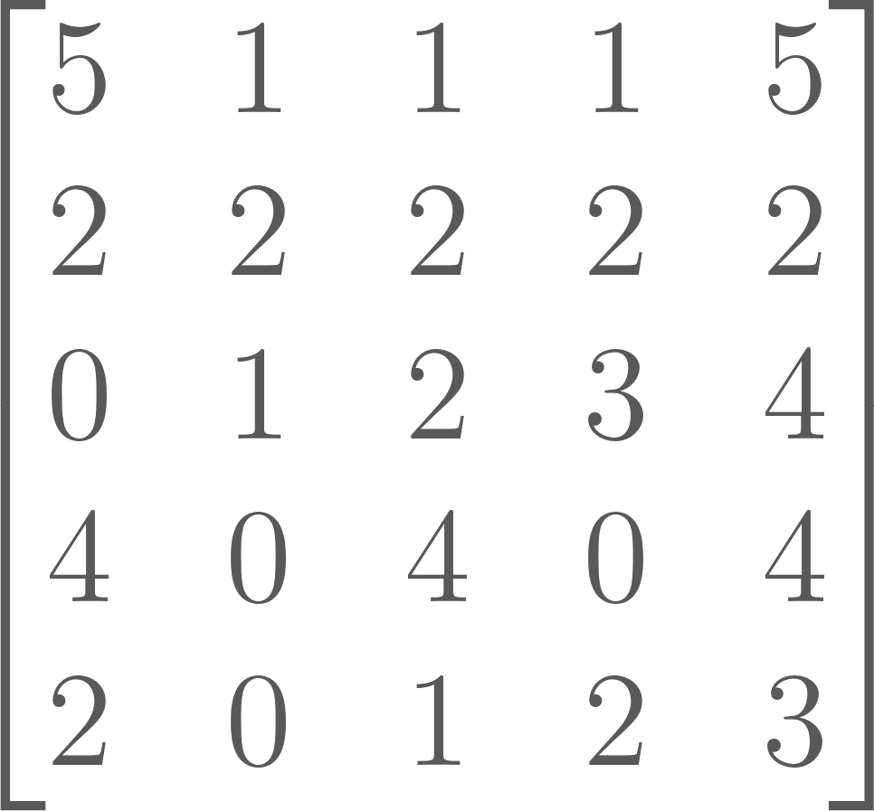
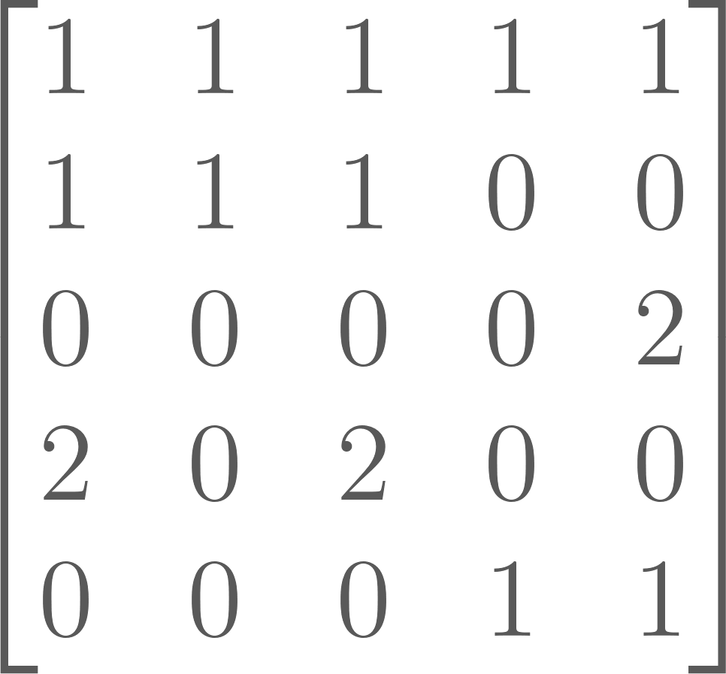
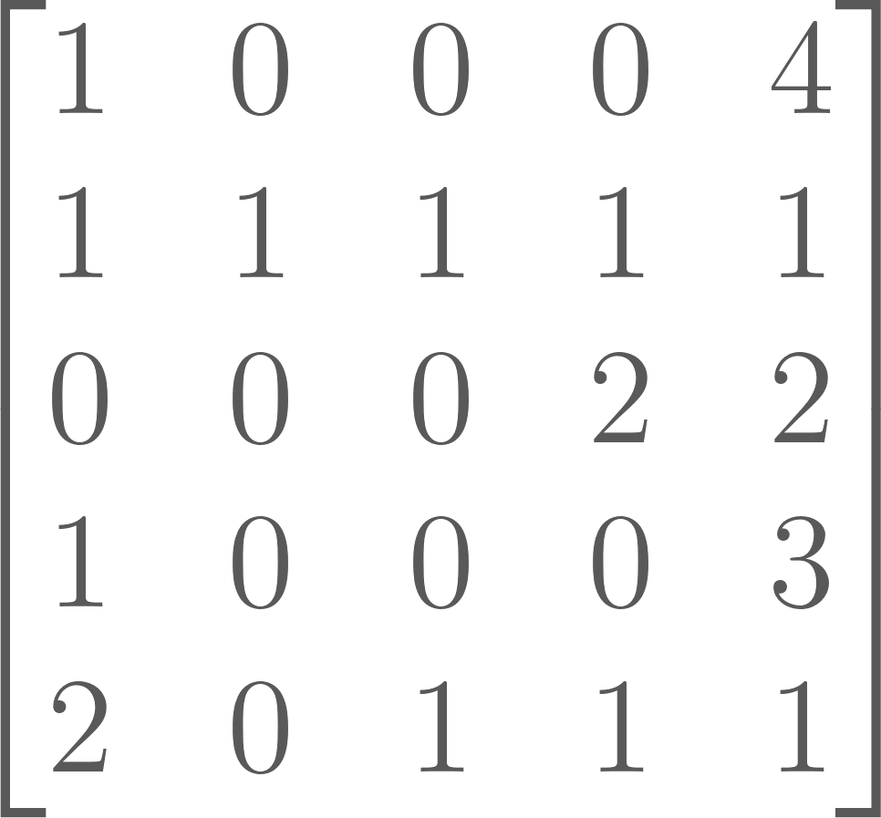
Q10. ISI M.Tech CS Semester Exam 2011
Consider the following Resource Allocation State involving 5 processes and 5 resources. Total = [ 5 4 5 3 6 ]
Max = Alloc = Req =
Total[i] specifies the total number of instances of resource i that exist in the system (including both allocated and free instances). Max [i, j], Alloc[i, j], and Req[i, j] denote, respectively:
• the maximum number of instances that process i may request of resource j,
• the number of instances of resource j currently allocated to process i, and
• the number of instances of resource j that process i is currently requesting.
Show that the system is neither in a safe state nor in a deadlocked state.

Slide 29
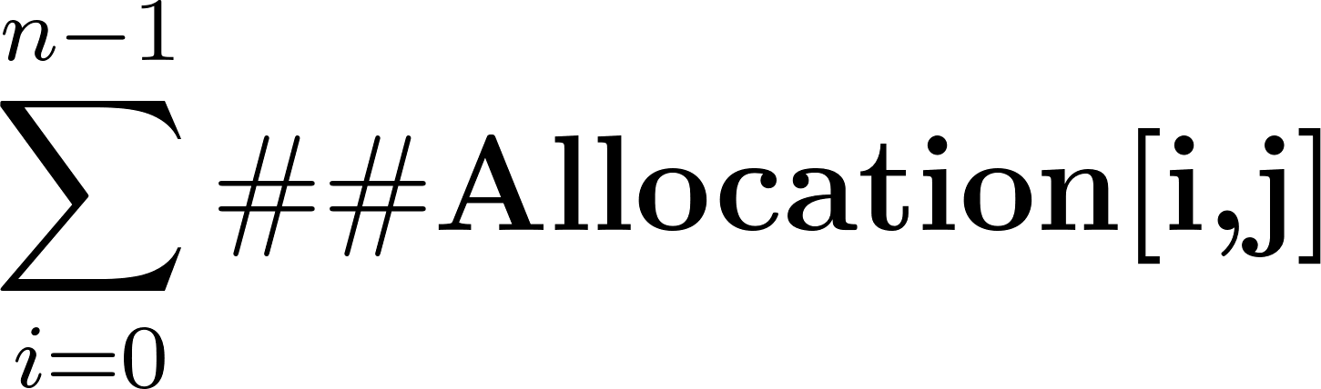
Solution to Q10
General Formulation:- Let n be the number of processes and m be the number of resource types.
Available: A vector of length m indicating the number of available resources of each type. Available[j]=Total[j]−
Max: An n×m matrix defining the maximum demand of each process.
Allocation: An n×m matrix defining the number of resources currently allocated to each process.
Need: An n×m matrix indicating the remaining resource need of each process (Need=Max−Allocation).
Request: An n×m matrix indicating the current outstanding requests of each process.
Safety Analysis (Is the system Safe?)
A state is Safe if there exists a sequence of processes such that all can finish (Need≤Available).
Deadlock Detection (Is the system Deadlocked?)
A system is Deadlocked only if no process can make progress based on its current Request matrix. We check if any Request_{i} ​≤ Available. For sequence (P1​,P4​,P2​,P3​,P0​), all current requests are met.

Slide 30
Solution to Q10 (contd.) Non-deadlocked Sequence
Check P1​: Request [1,1,1,1,1]≤Available[1,2,1,1,2]. True.
P1​ can finish. New Available=Available+Alloc(P1)​=[1,2,1,1,2]+[1,1,1,0,0]=[2,3,2,1,2].
Check P3​: Request [1,0,0,0,3]≤Available[2,3,2,1,2]. False (needs 3 of R4​).
Check P4​: Request [2,0,1,1,1]≤Available[2,3,2,1,2]. True.
P4​ can finish. New Available=Available+Alloc(P4)​=[2,3,2,1,2]+[0,0,0,1,1]=[2,3,2,2,3].
Check P2​: Request [0,0,0,2,2]≤Available[2,3,2,2,3]. True.
P2​ can finish. New Available=[2,3,2,2,3]+[0,0,0,0,2]=[2,3,2,2,5].
Check P3​: Request [1,0,0,0,3]≤Available[2,3,2,2,5]. True.
P3​ can finish. New Available=[2,3,2,2,5]+[2,0,2,0,0]=[4,3,4,2,5].
Check P0​: Request [1,0,0,0,4]≤Available[4,3,4,2,5]. True.
All processes can finish.

Slide 31
Q11. Gate 2018
Consider a system with 3 processes that share 4 instances of the same resource type. Each process can request a maximum of K instances. Resources can be requested and releases only one at a time. The largest value of K that will always avoid deadlock is ___
For n processes where each process P_{i} has a maximum demand : The condition for a deadlock-free environment is:
Here, 3(K-1) < 4. Hence, largest value of K is 2.

Slide 32
Q12. Gate 2021
Consider a computer system with multiple shared resource types, with one instance per resource type. Each instance can be owned by only one process at a time. Owning and freeing of resources are done by holding a global lock . The following scheme is used to own a resource instance:
function OWNRESOURCE(Resource R)
Acquire lock L // a global lock
if R is available then
Acquire R
Release lock L
else
if R is owned by another process P then
Terminate P, after releasing all resources owned by P
Acquire R
Restart P
Release lock L
end if
end if
end function
Which of the following choice(s) about the given scheme is/are correct?
The scheme ensures that deadlocks will not occur
The scheme may lead to live-lock
The scheme may lead to starvation
The scheme violates the mutual exclusion property

Slide 33
Solution to Q12
A system is in Deadlock when all the processes are in Waiting state.
A system is in Livelock when the processes do repeated work without any progress for the system (still no useful work).
Now, both deadlock and livelock are mutually exclusive – at any point of time only one can happen in a system. But both of them imply no progress for system and hence starvation for the processes involved.
Now, coming to the given question, any process can kick out another process and then acquire the nedeed resource and this can go in a cyclic fashion ensuring a livelock. There is no possibility of a deadlock as at any time a process is free to kick out another process. Since there is a possibility of livelock, starvation possibility is also there. So, options A, B and C are TRUE.
A process is acquiring the resource owned by another process only after terminating the other process. Hence there is no violation of mutual exclusion property here.
Correct Answer: A;B;C.

Slide 34
ISI MTech - 2010
Let P = {P1, P2, P3, P4} be a set of processes, and R = {R1, R2, R3, R4} be a set of resources. You are told that each resource Ri (1 ≤ i ≤ 4) has exactly two instances and each process Pi (1 ≤ i ≤ 4) requires at most one instance of any resource. Construct a RAG G = (P ∪ R, E), such that
(i) G has a cycle and P1, P2, P3 and P4 are deadlocked
(ii) G has a cycle but P1, P2, P3 and P4 are not deadlocked

Slide 35
Q13. ISI MTech - 2010
Let P = {P1, P2, P3, P4} be a set of processes, and R = {R1, R2, R3, R4} be a set of resources. You are told that each resource Ri (1 ≤ i ≤ 4) has exactly two instances and each process Pi (1 ≤ i ≤ 4) requires at most one instance of any resource. Construct a RAG G = (P ∪ R, E), such that
(i) G has a cycle and P1, P2, P3 and P4 are deadlocked
Cycle:
P1, R2, P3, R4, P4, R1, P1,..
R1
R3
Request Edge
P1
P2
P3
P4
Assignment Edge
R2
R4

Slide 36
Q13. ISI MTech - 2010
Let P = {P1, P2, P3, P4} be a set of processes, and R = {R1, R2, R3, R4} be a set of resources. You are told that each resource Ri (1 ≤ i ≤ 4) has exactly two instances and each process Pi (1 ≤ i ≤ 4) requires at most one instance of any resource. Construct a RAG G = (P ∪ R, E), such that
(ii) G has a cycle but P1, P2, P3 and P4 are not deadlocked
Cycle:
P1, R2, P2, R1, P1..
R1
R3
Request Edge
P1
P2
P3
P4
Assignment Edge
R2
R4

Slide 37
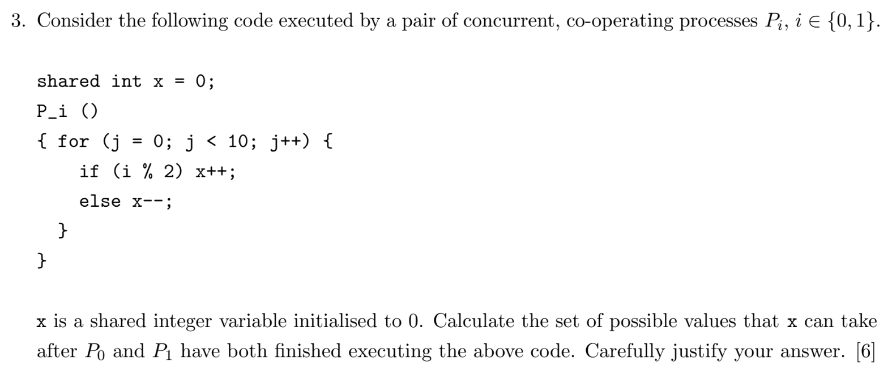
Q14. ISI MTech 2010

Slide 38
Solution
P0 - increments x 10 times
P1 - decrements x 10 times
Increment and decrement operations are not atomic
Read x
Modify
Write x
If operations are perfectly synchronized, x = 0
Race condition:
For a pair of increment and decrement operations,
Both successfully execute, net effect, x = 0
Increment overwrites decrements, net effect is +1
Decrement overwrites increment, net effect is -1
There are 10 such pairs, therefore -10 <= x <= 10

Slide 39
Q15. ISI MTech 2010
Consider the first readers-writers problem (where readers have priority). Suppose that the readers and writers use semaphores to synchronise their operation. Write the algorithm/pseudo-code for the reader and writer processes.
Explain whether your solution satisfies the bounded-waiting property.

Slide 40
Solution
semaphore wrt = 1; // controls access to shared resource
int readcount = 0; // number of active readers
semaphore mutex = 1; // protects readcount

Slide 41
Solution
Writer() {
wait(wrt);
// --- Writing (CS) ---
write();
signal(wrt);
}
Reader() {
wait(mutex);
readcount++;
if (readcount == 1)
wait(wrt); // first reader blocks writers
signal(mutex);
// --- Reading (CS) —
read();
wait(mutex);
readcount--;
if (readcount == 0)
signal(wrt); // last reader allows writers
signal(mutex);
}
Bounded Waiting: Not satisfied as a writer might have to wait when the readers keep on coming, making the wait time for writer unbounded.

Slide 42
Q16. ISI MTech 2012
Consider the following solution to the standard Dining Philosophers problem.
semaphore chopstick[5] = {1,1,1,1,1};
while (1) {
think();
wait(chopstick[i]); wait(chopstick[(i+1) % 5]);
eat();
signal(chopstick[i]); signal(chopstick[(i+1) % 5]);
}
Recall that the above solution is not deadlock-free. One way to avoid deadlock is to have odd philosophers pick up their left chopstick first, while even philosophers pick up their right chopstick first (or vice versa). Suggest an alternate deadlock-free, semaphore-based solution to this synchronisation problem. (hint: Use 1b.)

Slide 43
Solution
Allow only 4 philosophers to compete at a time by using semaphores
semaphore chopstick[5] = {1,1,1,1,1}; // 5 chopsticks are available
semaphore room = 4; // at most 4 philosophers allowed to try

Slide 44
Solution
while (1) {
think();
wait(room); // enter room
wait(chopstick[i]); // left chopstick availability check
wait(chopstick[(i+1) % 5]); // right chopstick availability check
eat();
signal(chopstick[i]); // put back left chopstick
signal(chopstick[(i+1) % 5]); // put back the right chopstick
signal(room); // leave room
}
Even if everyone simultaneously grabs a chopstick we still have 1 left to break the deadlock

